Slide 1



Medical - X
Medical Health Insurance Prediction
William Binitie
Chris Mary Bulatao
Galgamuge Emmanuel Fernando
Vihangi Kolamunna
Yolimar Rios

Slide 2
Introduction
In the rapidly evolving world of healthcare and insurance, the ability to predict and understand medical insurance's future needs and benefits has become essential. Integrating advanced technologies and data analytics has paved the way for predictive modeling, offering a transformative approach to assessing and addressing the diverse challenges within the industry.
Our topic will predict what the insurance cost of a person will have to pay after considering different features.

Slide 3
Dataset
4968 records.
Format: CSV
Country: USA
Trained 2 models:
20% test data & 80% train data.
30% test data & 70% train data.

Slide 4






Features
Age
Gender
BMI
Children
Region
Smoker

Slide 5

Label
Charges

Slide 6
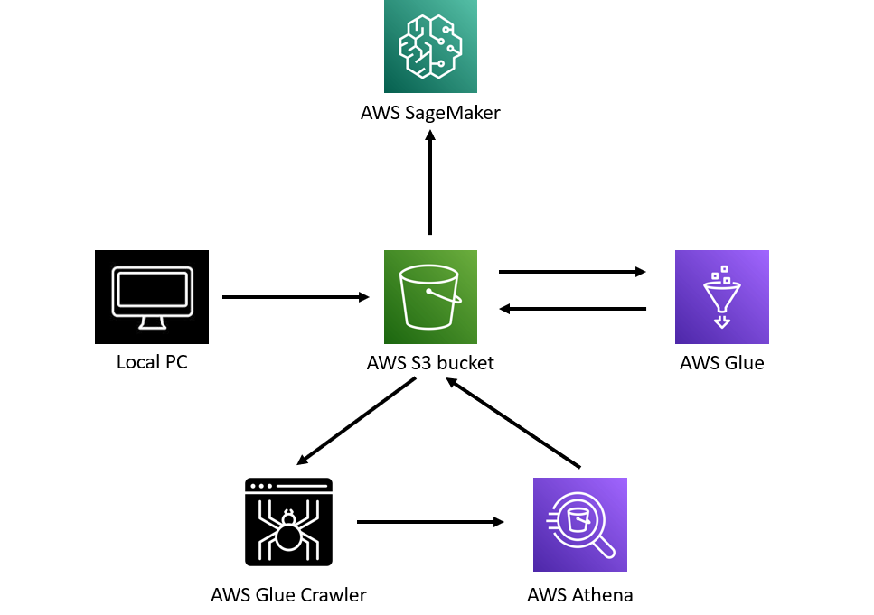
Architecture

Slide 7
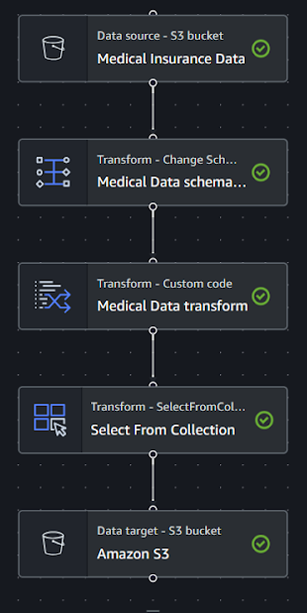
Extract, Transform and Load

Slide 8
Extract, Transform and Load
def MyTransform (glueContext, dfc) -> DynamicFrameCollection:
selected_df = dfc.select(list(dfc.keys())[0]).toDF()
selected_df = selected_df.withColumn("age", selected_df["age"].cast("int"))
selected_df.createOrReplaceTempView("medicalInsuranceData")
totals = spark.sql("select age, CASE WHEN sex = 'female' THEN 0 ELSE 1 END as sex, bmi, children, CASE WHEN smoker = 'yes' THEN 1 ELSE 0 END as smoker, region, charges FROM medicalInsuranceData")
results = DynamicFrame.fromDF(totals, glueContext, "results")
return DynamicFrameCollection({"results": results}, glueContext)

Slide 9
Data Analysis
Service used: AWS Athena
Transformed data from S3 is in CSV format.
Imported to AWS Athena via a web crawler.
Athena can show it as an SQL table where data analysts can run queries upon the data and identify traits and patterns of the data

Slide 10
Data Visualization
Data visualization is done to have a graphical viewpoint which is easier to understand.
Helps identifying patterns in data.
Mostly focuses on finding the relationship of what and how much the dependent variable depends on the independent variables.

Slide 11
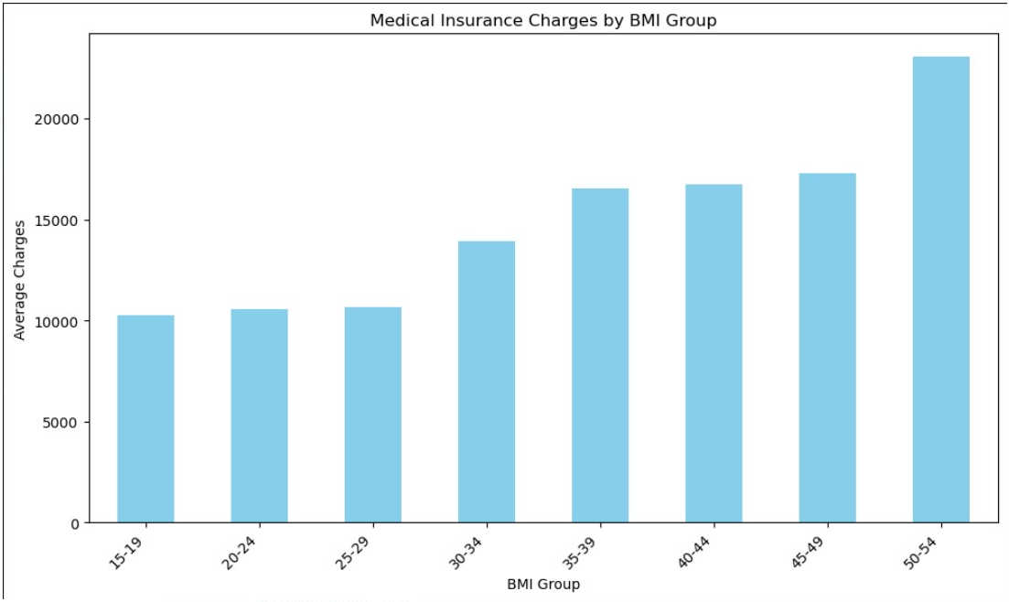
Bar Chart

Slide 12
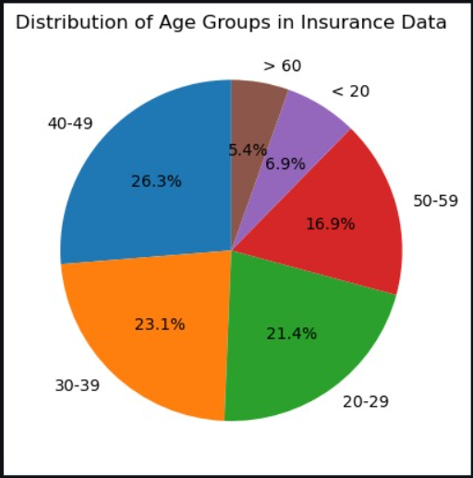
Pie Chart

Slide 13
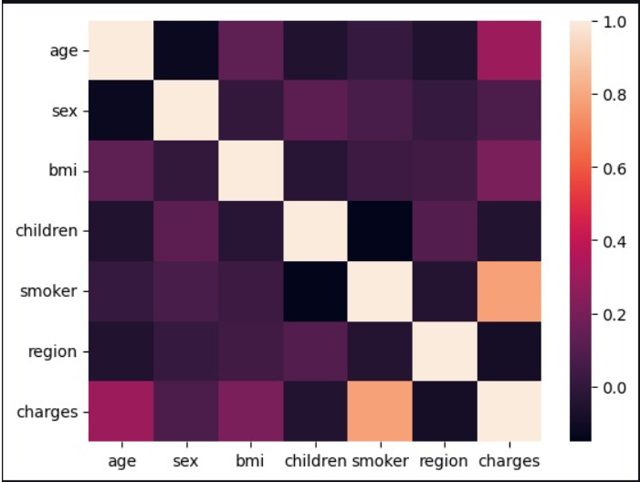
Heat Map

Slide 14
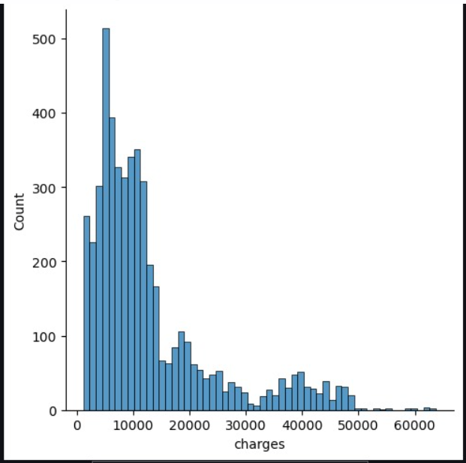
Histogram

Slide 15
Building, Training and Evaluating Model
Service used: AWS SageMaker
Algorithm used: Linear Regression.
Libraries Used:
Pandas - used for data analysis and data manipulation.
Numpy - used to implement multi-dimensional data structures.
Matplotlib - helps in plotting graphs
Seaborn - used to visualize statistical graphics
Plotly - browser-based graphing library.

Slide 16
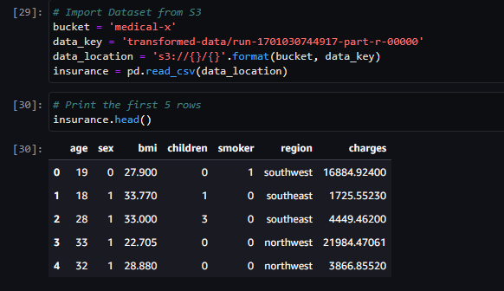
Importing dataset

Slide 17
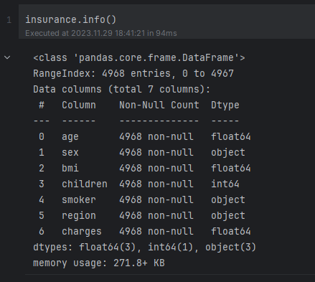
Dataset information

Slide 18
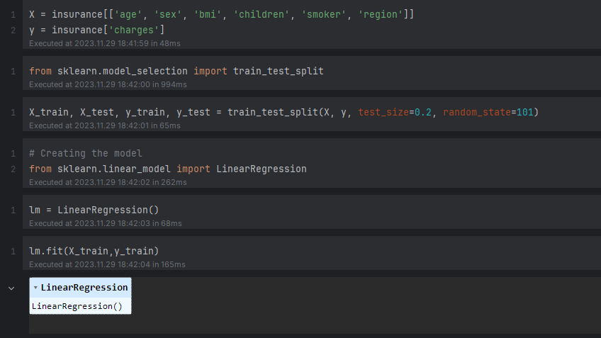
Building the model

Slide 19
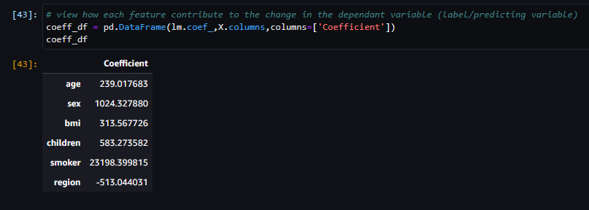
Co-efficient

Slide 20
Model Evaluation
Model Evaluation | 80 - 20 % | 70 - 30 %
Mean Absolute Error | 3772.42 | 3918.62
Mean Squared Error | 29452719.92 | 32073984.94
Root Mean Squared Error | 5427.04 | 5663.39

Slide 21



THANK YOU

